Slide 1
TTM FORUM JUNE 2017

Slide 2
XXX
Xxxx

Slide 3
Angus Bargh LINZ

Slide 4
Luke Thomas Traveller Info

Slide 5
The Importance of Accurate Information
Keeping the digital customer front of mind

Slide 6
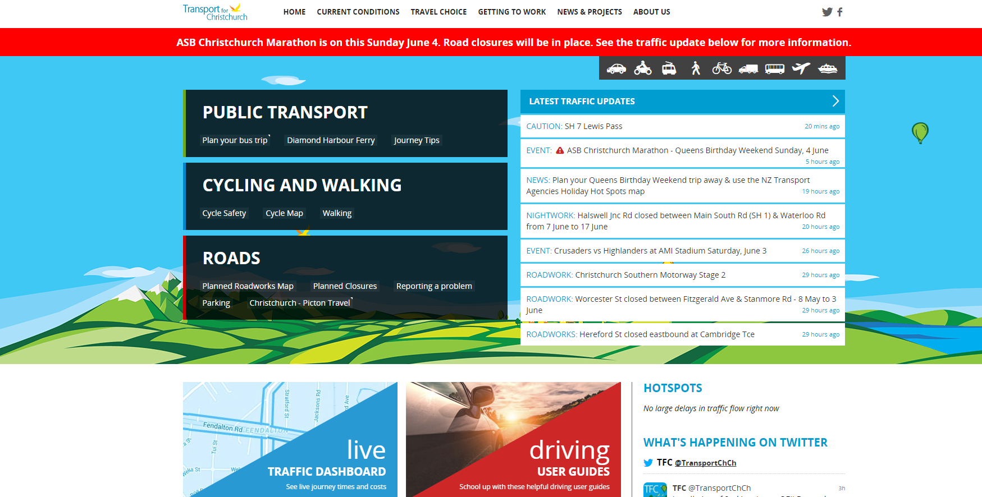

Slide 7
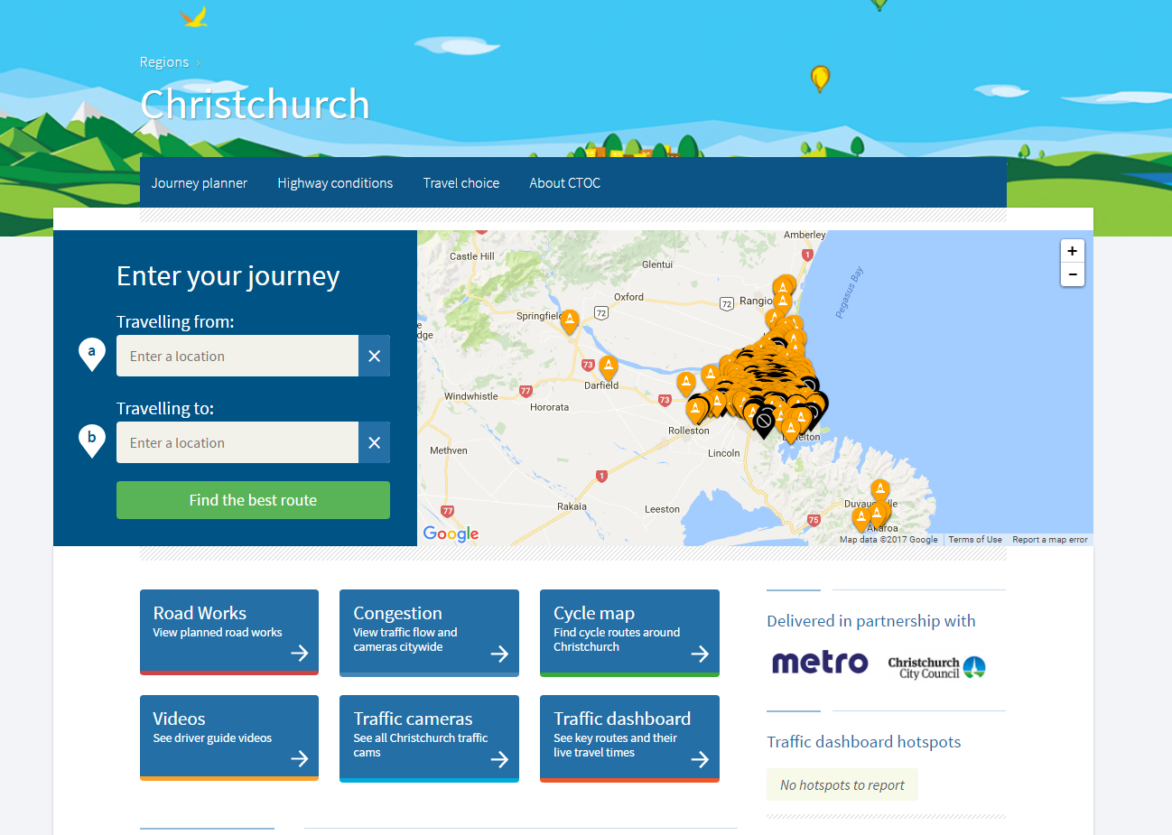

Slide 8
Transport for New Zealand
A journey planner
Multi modal travel options
Google data
Better integration and consistency of NZTA, ECAN and CCC data
Weather information

Slide 9
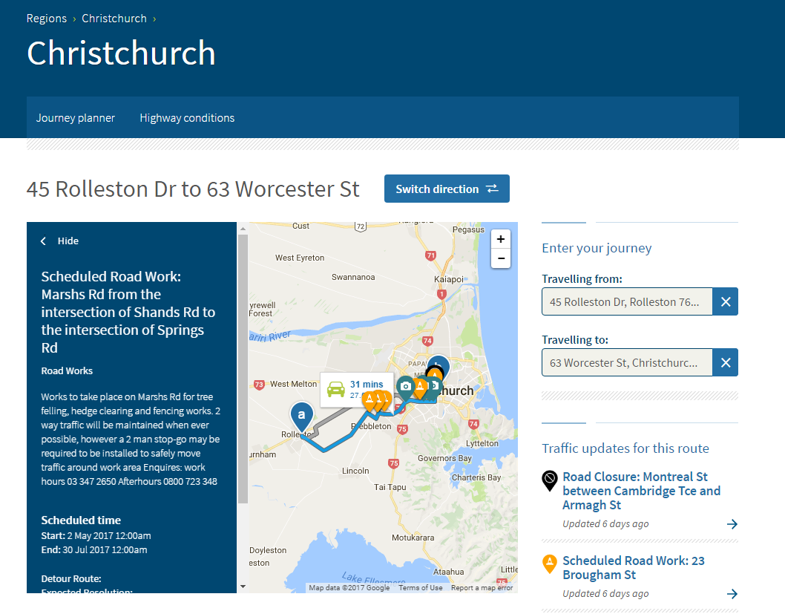

Slide 11
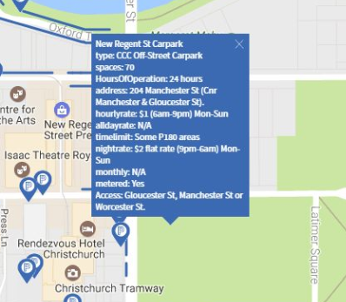

Slide 12
Data needs to be accurate!
Increase awareness
Customer satisfaction
Reputation
Digital future
Work together
Training
We need to prepare for ‘smart’ technology

Slide 13
Bev Wilmshurst Transport Planner

Slide 14
T.I.A Guide Release

Slide 15
Questions
Who knows what a T.I.A is?
Who saw that the T.I.A guide was released?
Who looked at it?

Slide 16
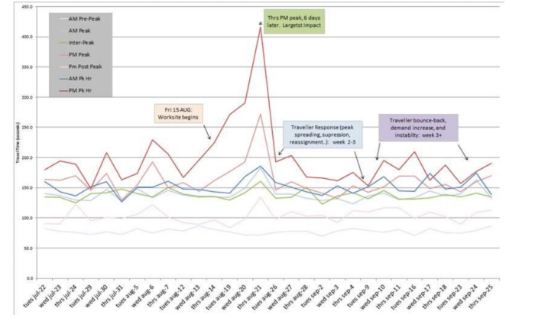
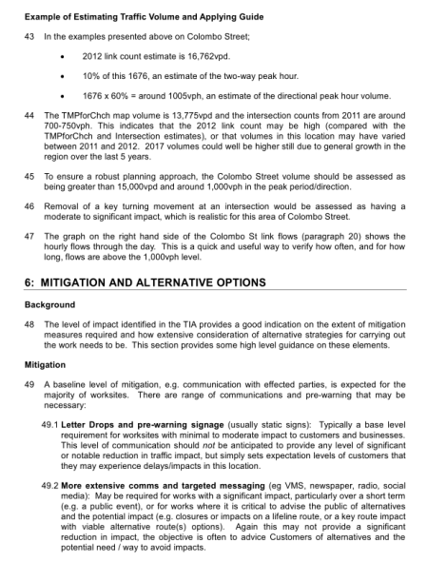
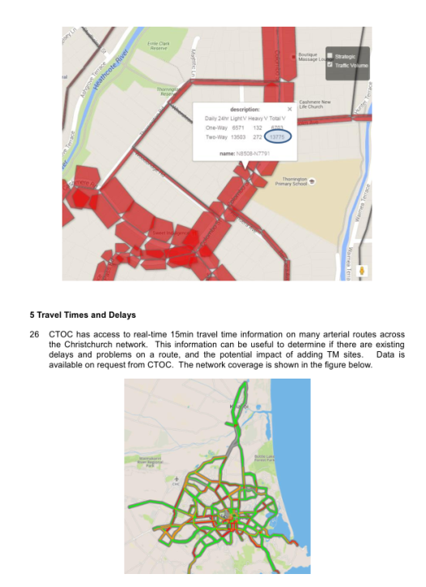
Key Aspects
Long
(parts are) Complicated

Slide 17
But!!!!
The whole doc is not relevant to everyone

Slide 18
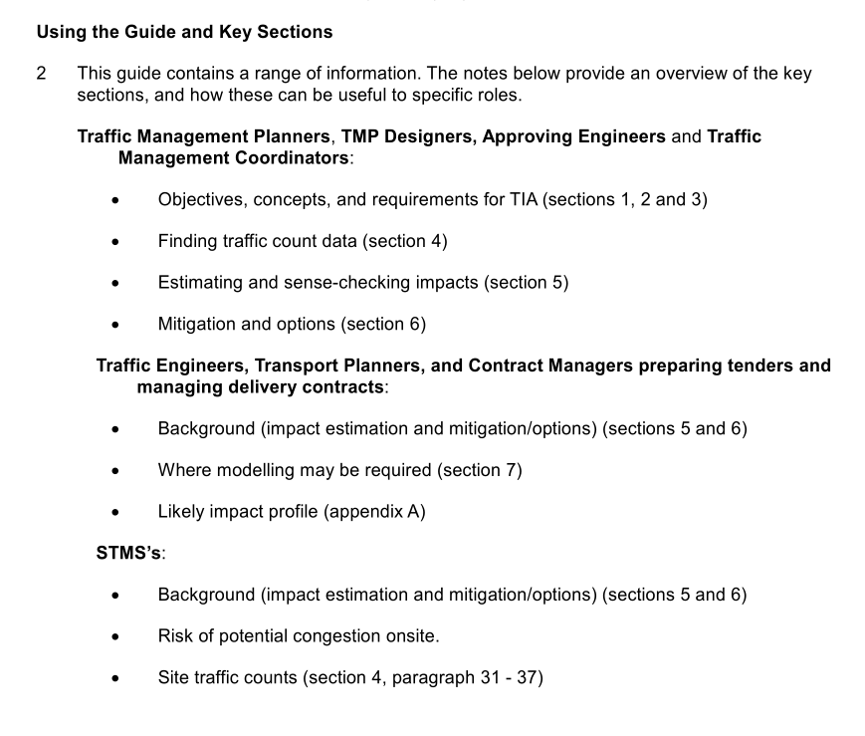

Slide 19
TM Planners, TMP Designers
Objectives (section 1)
Estimate impact on network
Identify mitigation requirements
Assess the balance of the approach
Consider alternatives delivery options

Slide 20
TM Planners, TMP Designers
Key Concepts (section 2)
TM arrangements:
Lane drop
Intersection capacity reduction
Stop-go
Detour
Bus Route Detour
Intersection reconfiguration
Significant work at key location

Slide 21
TM Planners, TMP Designers
TIA requirements (section 3)

Slide 22
TM Planners, TMP Designers
TIA requirements (section 3)
Check: traffic flows as expected
Review: review flows, location, and potential impacts
Assess: assess flows, potential delays, customer impacts, consider potential alternative options
Robust Assess: assess flows, estimate delays, strategies to reduce impacts, alternative options
Full Assess: possible expert advice, modelling, assess alternatives, optimisation, alternatives

Slide 23
The Road So Far
Section 1: Objectives
Section 2: Concepts
Section 3: TIA Requirements
All good?

Slide 24
Section 4: Traffic Counts
Key aspects:
Where to find traffic count data

Slide 25
OK that’s not all that is section 4
Traffic Count bedtime reading;
Influence of Feb 11 quake
Checking several sources
How you can display in excel
Carry out site specific counts
Converting vph <-> vpd
Two-way and one-way calcs

Slide 26
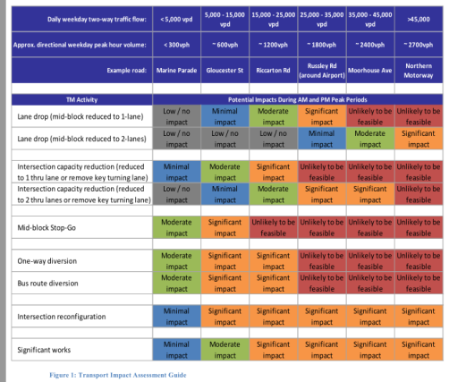
Sec 5: High Level Assessment Guide
Figure one
Traffic volumes
TM
Activity
Indication of potential impact

Slide 27
Potential Impacts (Guide!)
Low/no impact: No real delays
Minimal impact: Delays 1-2mins max at peaks
Moderate impact: Delays 5-10mins at peaks
Significant impact: >10min delays
Unlikely to be feasible: Without strong possibility of significant successful mitigation, unlikely to be supportable

Slide 28
Sec6: Alternatives & Mitigation
Mitigation: letter drops, pre-warning signage, more extensive comms
Alternatives: Re-timing, work method, resource, low cost alternations, movement controls

Slide 29
CBD UPDATE

Slide 30
Business parking in the CBD .
Co-ordination between work site .
How we can minimise worksites at the end of each day and weekends.
Be aware of the surroundings and communicate to stake holders.

Slide 31
CURRENT MAJOR PROJECTS IN CBD
RE SURFACING PROGRAME MONTREAL STREET.
RE SURFACING BEALEY AVE
AAC WORKS ON DURHAM AND MONTREAL
HOSPITAL CORNER WORKS (TUAM/ANITGUA)
ENABLE WORK CREWS VARIOUS LOCATION
ARP PROJECT .

Slide 32
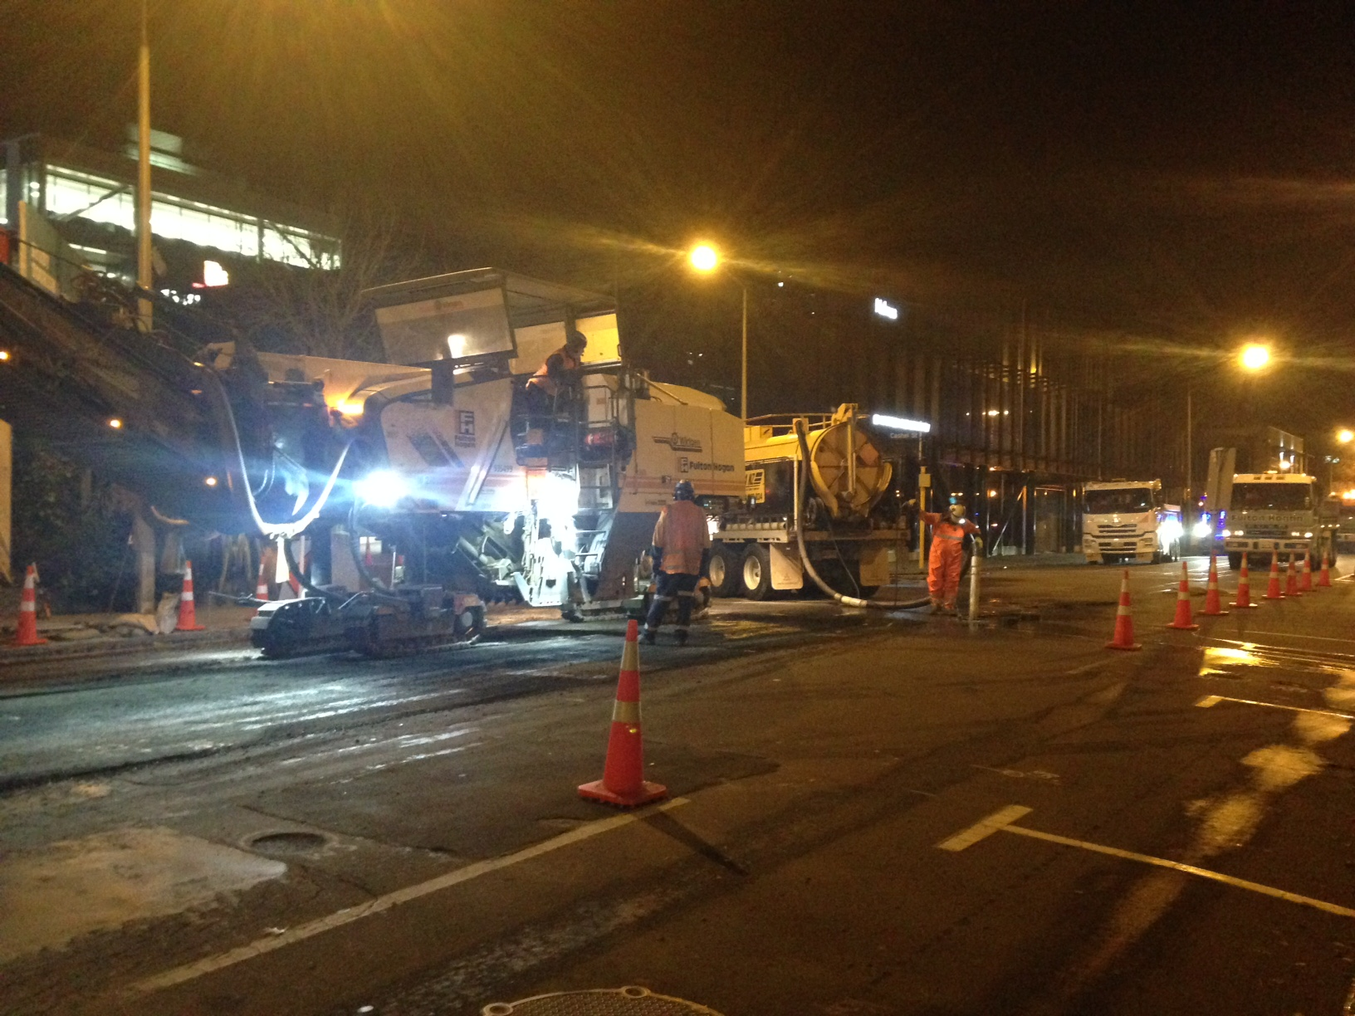
XXX
Xxxx

Slide 33
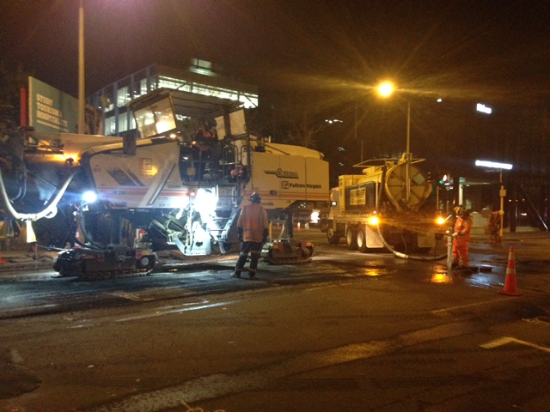
XXX
Xxxx

Slide 34
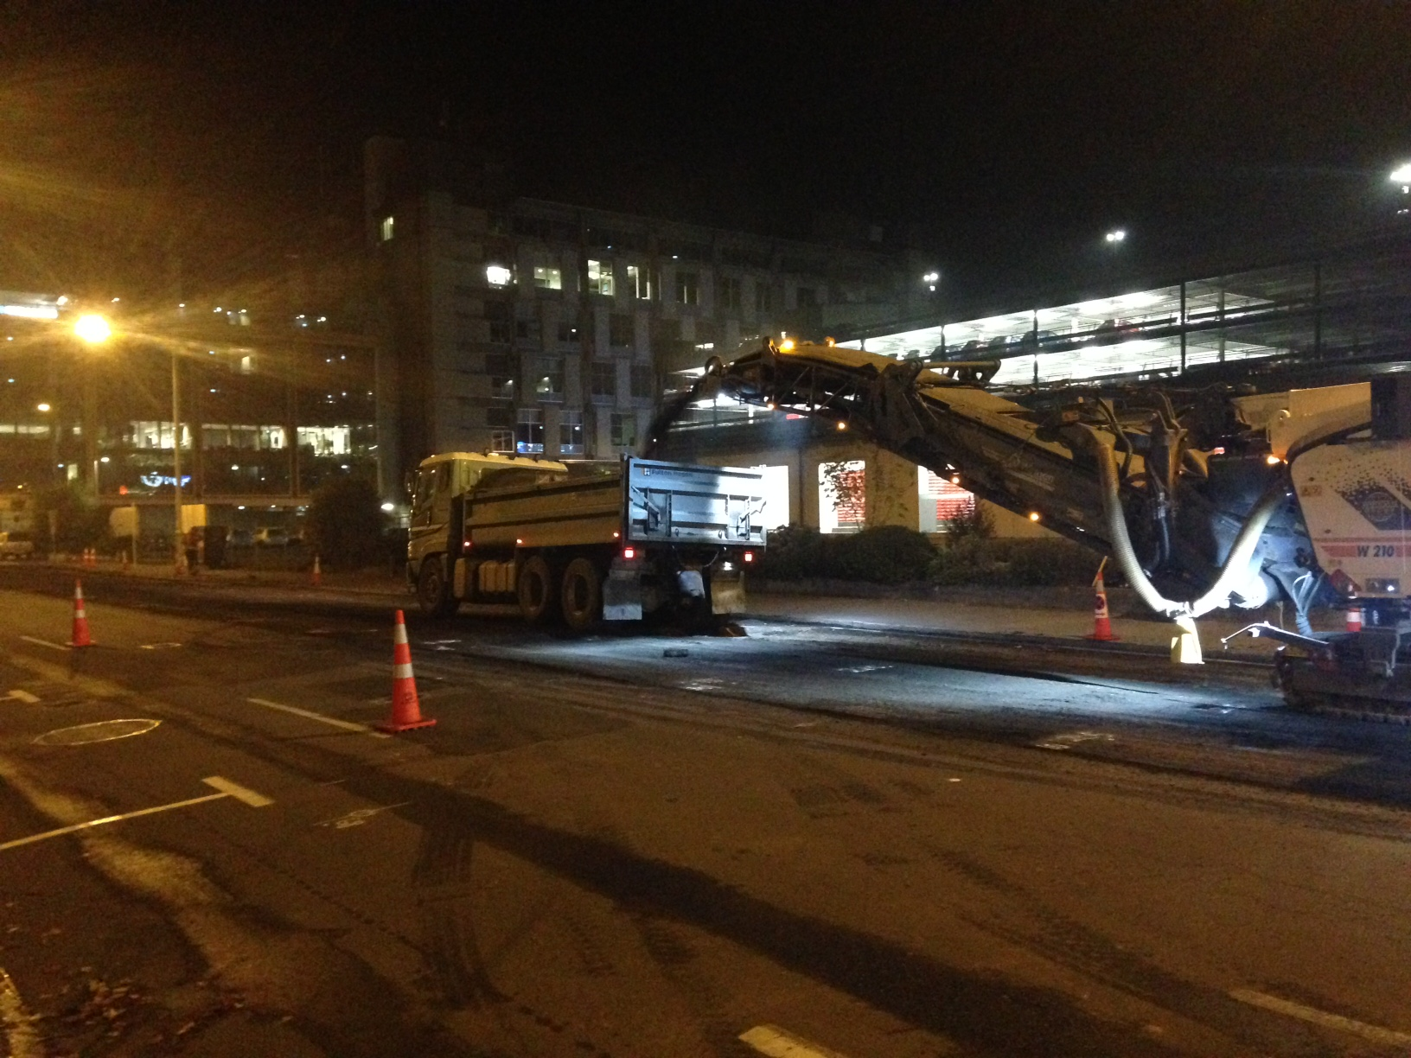
XXX
Xxxx

Slide 39
BRAINSTORMING

Slide 40
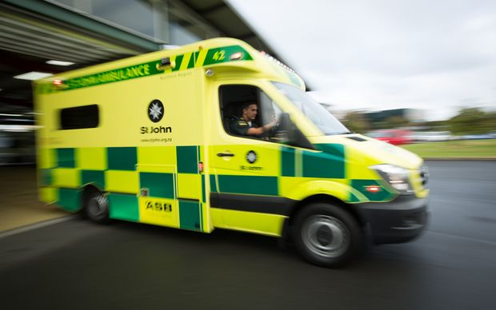
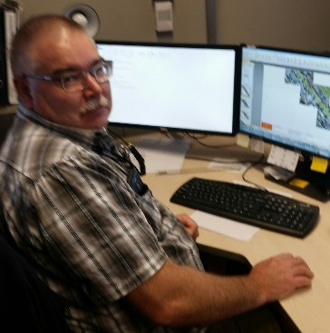
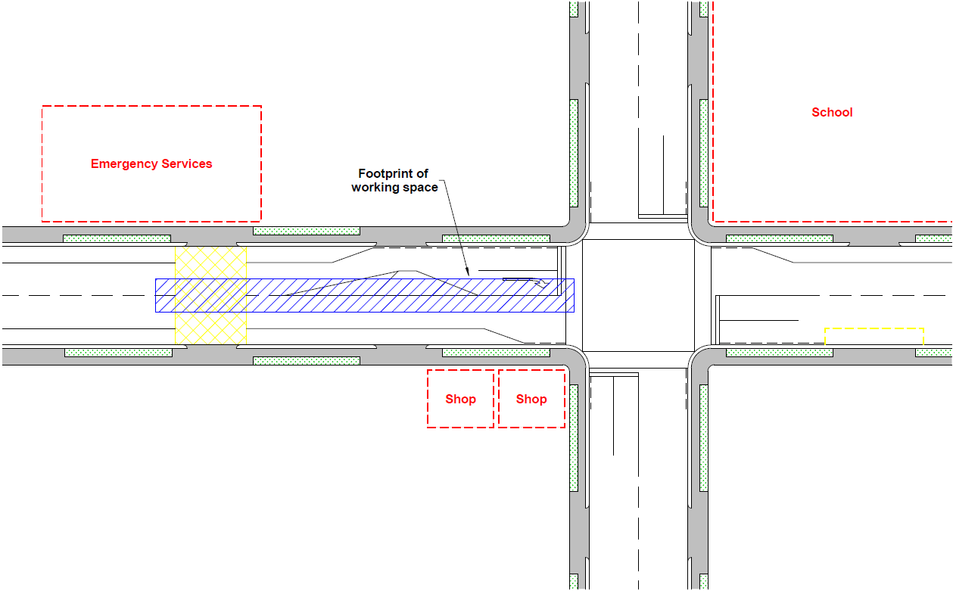
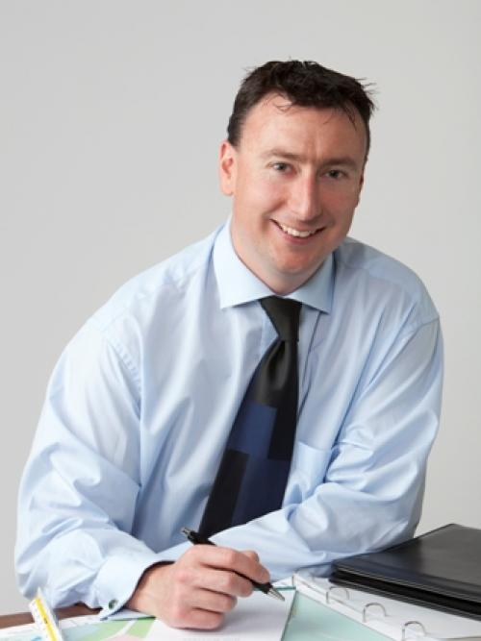
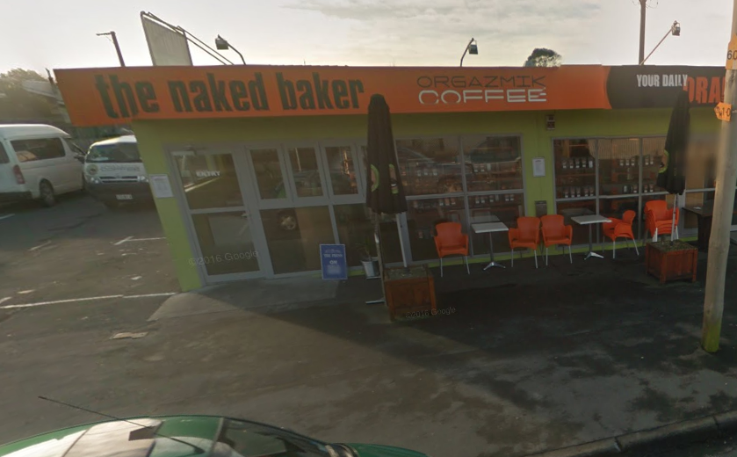
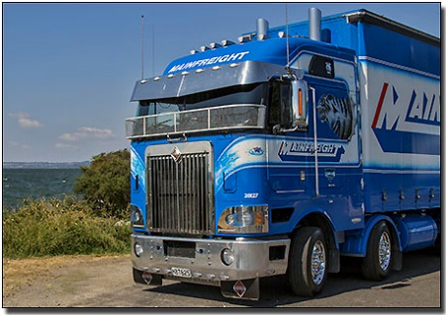
LAYOUT DIAGRAM

Slide 41
Chris Real Time Operations

Slide 42
RTO (Real Time Operations) Better known as Traffic Signals
Do RTO NEED To Know?

Slide 43
What do RTO do?

Slide 44
Graphics
Displays the phases / movements
Displays detector state

Slide 45
Scats
Data received from site is displayed.
It looks complex. This screen tells us how the site is running:
Cycle time
Phase splits & plan
Lamp state
Coordinated?
Messages

Slide 46
Playtime
Set phase %
Set phase order
Skip phases
Set phase features

Slide 47
Detectors
When detectors / loops are damaged, the alarm category needs to be changed. Also, our maintenance contractor may need to switch out the detector to stop a phase calling.
Detectors are the eyes and ears of the intersection. Without them, the intersection will not run efficiently.

Slide 48
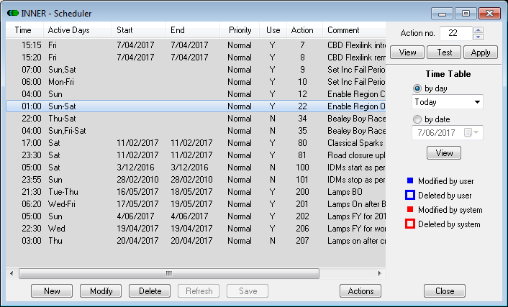
Schedules
The engine used to schedule planned works ie flashing yellow

Slide 49
Actions
The coded information per action
The scheduler runs the relevant selected action

Slide 50
Light Reading!
Currently we monitor 335 sites
Each site has it’s unique set up
Can we do what you want? Not always.
Tell us what you want to achieve and we will try to do it!

Slide 51
Cameras
Sometimes a picture says 1000 words!
Be aware, big brother is watching!

Slide 52
Simon Harty Rubbish Collections

Slide 53
Hayden Muir Update On NOC

Slide 55
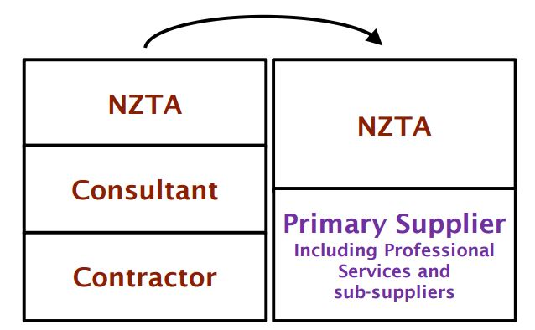
Changes from previous hybrid contract

Slide 56
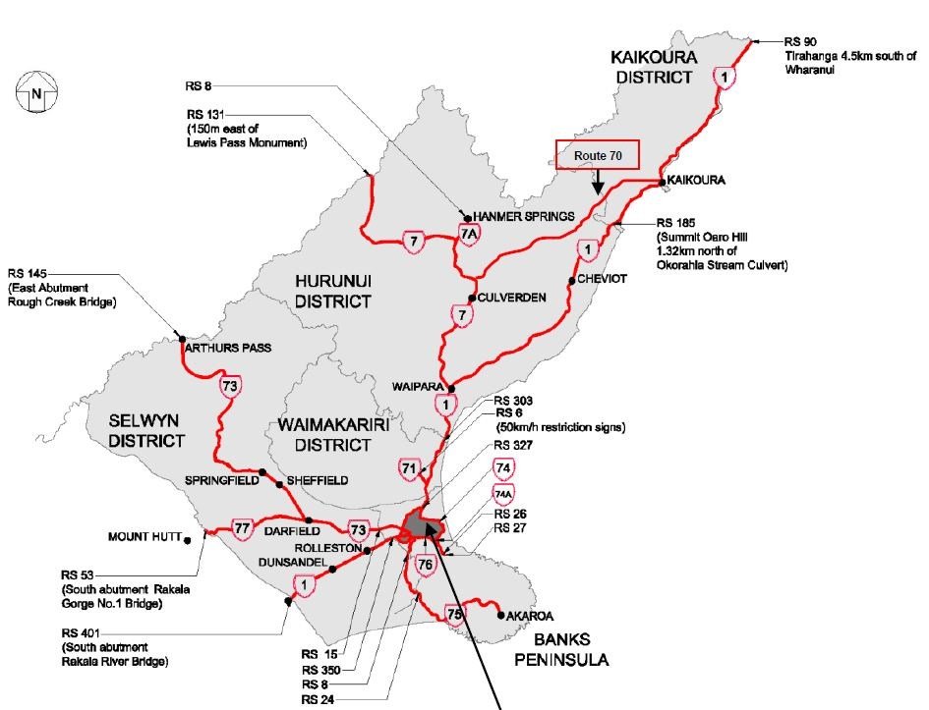
Changes from previous hybrid contract

Slide 57
Southern Link Canterbury Suppliers

Slide 58
North Canterbury State Highways Network Outcomes Contract (NOC)
The core maintenance activities covered by the NOC include:
Network Management - asset management, journey management and safety management
Physical works – maintenance and renewals of sealed pavement, drainage and structures, environmental maintenance, traffic services and operational traffic services

Slide 59
Network Controls
CAR’s and WAP’s
Used to “track” others in the NZTA corridor (Ramm CAR Manager)
Used to place “conditions” on work undertaken by others(time, depths, quality etc)
Why do we care? Because we are responsible for the long term quality of the asset and take on the responsibility for the work once completed
Traffic Management
We approve and coordinate TMP’s across the network outside of Christchurch City Boundaries (ours and 3rd parties)
We set temporary speed restrictions (delegated to us from NZTA)

Slide 60
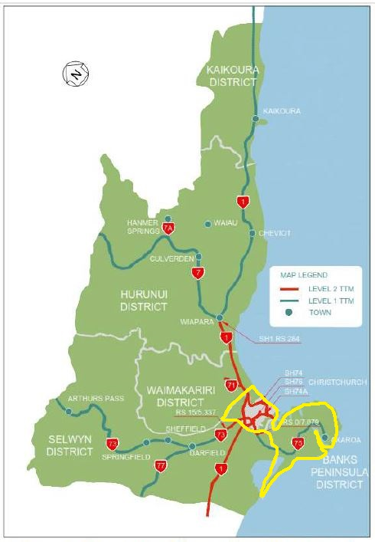
TMC jurisdiction boundaries

Slide 61
TMC contact Details
Hayden.Muir@opus.co.nz
027 432 6467
James.Park@opus.co.nz
027 434 3255
24/7 Emergency response– 03 363 5519

Slide 62
Incident Response
Attending, coordinating and tiding up at crashes, fires, truck roll overs, spilt loads, breakdowns etc
Liaison with Emergency Services and Public
Traffic control
Updating Comms team
Incident response plans
24/7 Emergency response– 03 363 5519

Slide 63
LUNCHTIME

Slide 64
BRAINSTORMING

Slide 65
Can you get into 6 groups
Are the system that we have in place ok?
Improvement ideas?
Can you write down ideas .Person from each group to present ideas and have open discussion at the end of the 20min session .

